Slide 1
Software Engineering
Wei-Min Wu（吴为民）
School of Petroleum
China University of Petroleum - Beijing at Karamay
Fall, 2025

Slide 2
Chap. 5 System modeling
Topics covered
Context models 上下文模型
Interaction models 交互模型
Structural models 结构模型
Behavioral models 行为模型
Model-driven architecture 模型驱动的体系结构

Slide 3
Chap. 5 System modeling
UML: a standard language for object-oriented modeling. It supports the creation of many different types of system model.
System modeling 系统建模
System modeling is the process of developing abstract models of a system, with each model presenting a different view or perspective of that system. 含义：开发系统抽象模型的过程
System modeling now usually means representing a system using graphical notation based on Unified Modeling Language (UML). 通常采用基于UML的图形表示
Models are used during the requirements engineering process to help derive the detailed requirements, during the design process to describe the system to engineers, and after implementation to document the system’s structure and operation. 模型的用途

Slide 4
Chap. 5 System modeling
Existing and new system models 现有和新系统模型
Models of the existing system are used during RE. They help clarify what the existing system does, and they can be used to focus a stakeholder discussion on its strengths and weaknesses. 现有系统模型:阐明系统做什么
Models of the new system are used during RE to help explain the proposed requirements to other system stakeholders. Engineers use these models to discuss design proposals and to document the system for implementation. 新系统模型:向其他干系人解释提出的需求
In a model-driven engineering process, you can generate a complete or partial system implementation from the system model. 模型驱动的工程过程

Slide 5
Chap. 5 System modeling
System perspectives 系统视角
An external perspective, where you model the context or environment of the system. 外部视角:对上下文或环境建模
An interaction perspective, where you model the interactions between a system and its environment, or between the components of a system.交互视角:对系统与其环境、或构件间的交互建模
A structural perspective, where you model the organization of a system or the structure of the data processed by the system. 结构视角:对系统的组织或数据结构建模
A behavioral perspective, where you model the dynamic behavior of the system and how it responds to events. 行为视角:对系统的动态行为、及系统如何对事件反应建模

Slide 6
Chap. 5 System modeling
Use of graphical models 图形模型的用途
As a way to stimulate and focus discussion about an existing or proposed system. The models may be incomplete, and they may use the modeling notation informally. This is how models are normally used in agile modeling. 作为激励和聚焦讨论的方式
As a way of documenting an existing system. The models do not have to be complete, but have to be correct—should use the notation correctly and be an accurate description. 作为文档化现有系统的方式
As a detailed system description that can be used to generate a system implementation. The system models have to be both complete and correct, used as a basis for generating the source code. 用于生成系统实现

Slide 7
Chap. 5 System modeling
UML diagram types
The UML has 13 diagram types, 5 of them could represent the essentials of a system. 5个图类型即可
Activity diagrams, which show the activities involved in a process or in data processing. 活动图
Use case diagrams, which show the interactions between a system and its environment. 用例图
Sequence diagrams, which show interactions between actors and the system and between system components. 顺序图
Class diagrams, which show the object classes in the system and the associations between these classes. 类图
State diagrams, which show how the system reacts to internal and external events. 状态图

Slide 8
Chap. 5 System modeling
5.1 Context models 上下文模型
At an early stage in the specification of a system, you should decide on the system boundaries, that is, on what is and is not part of the system being developed. These decisions should be made early in the process to limit the system costs and the time needed for understanding the system requirements and design. 确定系统边界：哪些属于/不属于被开发的系统
Social and organizational concerns may mean that a system boundary may be determined by nontechnical factors. 边界可能由非技术因素决定
Once the boundaries are made, part of the analysis activity is the definition of that context and the dependencies that a system has on its environment. 边界确定后，就要定义上下文,以及系统对其环境的依赖

Slide 9
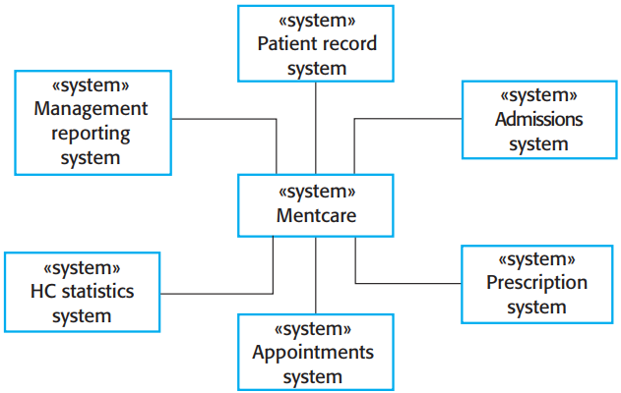

* Fig. 5.1 is a context model that shows the Mentcare system and other systems in its environment.
* You can see that the Mentcare system is connected to an appointments system and a more general patient record system with which it shares data.
* The system is also connected to systems for management reporting and hospital admissions, and a statistics system that collects information for research.
* Finally, it makes use of a prescription system to generate prescriptions for patients’ medication.

Slide 10
Chap. 5 System modeling
Process perspective 过程视角
Context models simply show that the environment includes several other automated systems. they do not show the types of relationships between the systems in the environment and the system that is being specified. 上下文模型未展示系统和环境之间的关系的类型
Therefore, context models are used along with other models, such as business process models. 因此，上下文模型要与业务过程模型一起使用
UML activity diagrams may be used to show the business processes. Figure 5.2 is a UML activity diagram that shows where the Mentcare system is used in an important mental health care process—involuntary detention. UML活动图，用于展示业务过程：非自愿留置

Slide 11
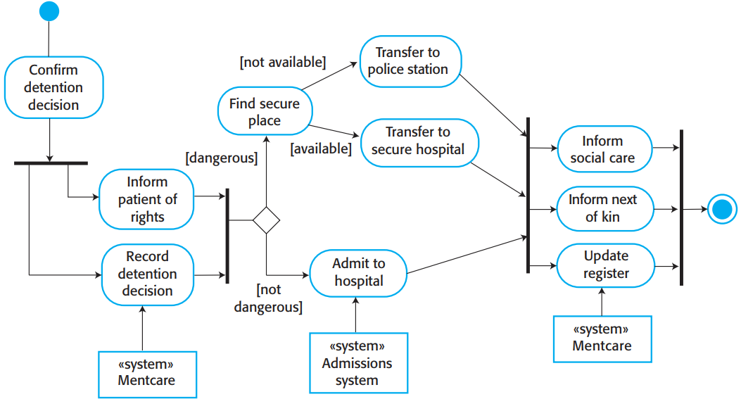

• UML activity diagrams show the activities in a process and the flow of control from one activity to another. The start of a process is indicated by a filled circle, the end by a filled circle inside another circle. Rectangles with round corners represent activities. Objects are separate systems shown by using The UML stereotype feature where the type of entity in the box between <<>> is shown. Arrows represent the flow of work from one activity to another, and a solid bar indicates activity coordination. When the flow from more than one activity leads to a solid bar, then all of these activities must be complete before progress. When the flow from a solid bar leads to a number of activities, these may be executed in parallel. Arrows may be annotated with guards (in square brackets) that specify when that flow is followed. 活动图中各种符号的解释

Slide 12
Chap. 5 System modeling
5.2 Interaction models 交互模型
User interaction modeling is important as it helps to identify user requirements. 用户交互:重要,有助于识别用户需求
Modeling system-to-system interaction highlights the communication problems. 系统间交互：突出通信问题
Modeling component interaction helps us understand if a proposed system structure is likely to deliver the required system performance and dependability. 组件间交互：有助于理解是否可以交付所要求的性能和可依赖性
This section discusses two related approaches to interaction modeling: Use case modeling, which is mostly used to model interactions between a system and external agents; Sequence diagrams, which are used to model interactions between system components, although external agents may also be included. 两种交互模型：用例建模和顺序图

Slide 13
Chap. 5 System modeling
Use case modeling 用例建模
Use cases were developed originally to support requirements elicitation and now incorporated into the UML. 用于需求抽取
Each use case represents a discrete task that involves external interaction with a system. In its simplest form, a use case is shown as an ellipse, with the actors involved in the use case represented as stick figures. 每个用例是一个离散的任务，涉及与系统的外部交互
Figure 5.3 shows a use case from the Mentcare system that represents the task of uploading data from Mentcare system to a more general patient record system. 例子:从Mentcare向更通用病例系统上传数据

Slide 14

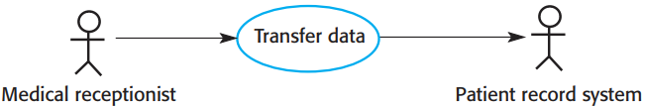
Chap. 5 System modeling
Transfer-data use case
* Notice that there are two actors in this use case—the operator who is transferring the data, and the patient record system. 两个参与者:医疗接待员、病例系统
* The stick figure notation was originally developed to cover human interaction, but it is also used to represent other external systems and hardware.
* The arrows in Figure 5.3 are used informally to indicate the medical receptionist initiates the transaction and data is transferred to the patient record system.
* Use case diagrams give a simple overview of interaction, you need to add more detail for complete description. The detail can either be a simple textual description, a structured description in a table, or a sequence diagram. You choose most appropriate format depending on the use case and the level of detail that you think is required in the model. See the next slide. 可加入更多细节：文本、表、顺序图

Slide 15
Chap. 5 System modeling
Tabular description of the ‘Transfer data’ use-case 表格描述
MHC-PMS: Transfer data
Actors | Medical receptionist, patient records system (PRS)
Description | A receptionist may transfer data from the Mentcase system to a general patient record database that is maintained by a health authority. The information transferred may either be updated personal information (address, phone number, etc.) or a summary of the patient’s diagnosis and treatment.
Data | Patient’s personal information, treatment summary
Stimulus | User command issued by medical receptionist
Response | Confirmation that PRS has been updated
Comments | The receptionist must have appropriate security permissions to access the patient information and the PRS.

Slide 16
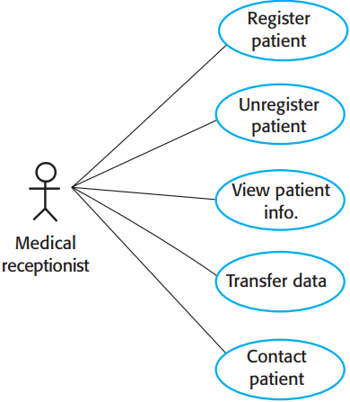
Chap. 5 System modeling
Use cases in the Mentcare system involving the role ‘ Medical Receptionist ’
* Composite use case diagrams show a number of different use cases. 复合用例图
* Sometimes it is possible to include all possible interactions within a system in a single composite use case diagram. However, this may be impossible because of the number of use cases. In such cases, you may develop several diagrams, each of which shows related use cases.
* Figure 5.5 shows all of the use cases in the Mentcare system in which the actor “Medical Receptionist” is involved. Each of these should be accompanied by a more detailed description. 展示了‘医疗接待员’涉及到的所有用例

Slide 17
Chap. 5 System modeling
Sequence diagrams 顺序图
Sequence diagrams are used to model the interactions between the actors and the objects and the interactions between the objects. 对交互建模:参与者与对象，对象之间
A sequence diagram shows the sequence of interactions that take place during a particular use case. 展示交互序列
Figure 5.6 is a sequence diagram that illustrates the notation. It models the interactions in the ‘ view patient information ’ use case. Objects and actors involved are listed along the top of the diagram, with a dotted line drawn vertically from these. Annotated arrows indicate interactions between objects. The rectangle on the dotted lines indicates the lifeline of the object concerned. You read the sequence of interactions from top to bottom. The annotations on the arrows indicate the calls to the objects, their parameters, and the return values. A box named alt is used with the conditions indicated in square brackets, with alternative interaction options separated by a dotted line. 例子: ‘查看病人信息’的用例图

Slide 18

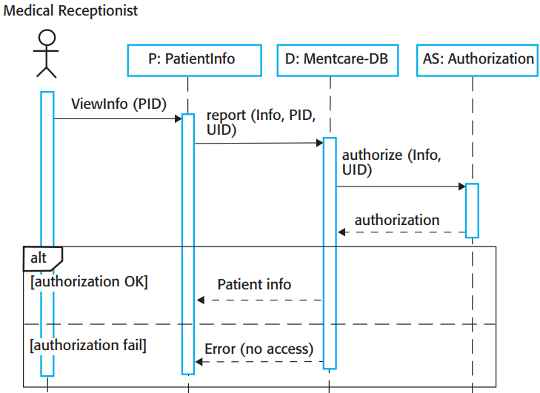
1. The medical receptionist triggers ViewInfo method in an instance P of the PatientInfo class, supplying the patient’s identifier, PID to identify the required information. P is a user interface object, which is displayed as a form showing patient information.
2. The P calls the database to return the information required, supplying the receptionist’s identifier to allow security checking. (Here, it is not important where the receptionist’s UID comes from.)
3. The database checks with an authorization system that the receptionist is authorized for this action.
4. If authorized, the patient information is returned and is displayed on a form on the user’s screen. If authorization fails, then an error message is returned. The box denoted by “alt” in the top-left corner is a choice box indicating that one of the contained interactions will be executed. The condition that selects the choice is shown in square brackets.

Slide 19
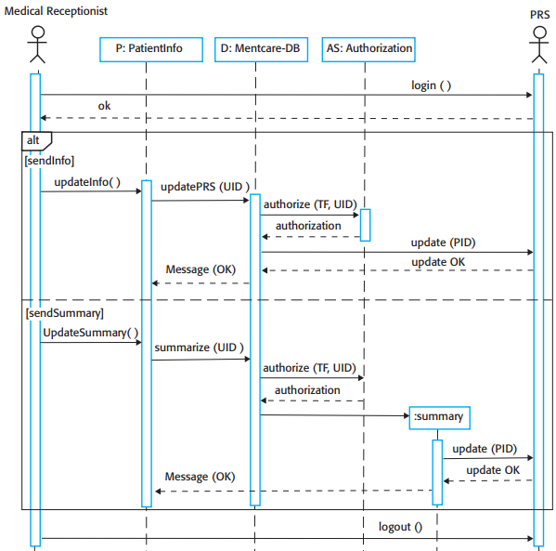

Figure 5.7 is a further example that illustrates two additional features. These are the direct communication between the actors and the creation of objects. An object of type Summary is created to hold the summary data that is to be uploaded to a national PRS.
1. The receptionist logs on to PRS(patient records system).
2. Two options are available. These allow the direct transfer of updated patient information from the Mentcare database to the PRS and the transfer of summary health data from the Mentcare database to the PRS.
3. Each case, the receptionist’s permissions are checked using the authorization system.
4. Personal information may be transferred directly from the user interface object to the PRS. Alternatively, a summary record may be created from the database, and that record is then transferred.
5. On completion of the transfer, the PRS issues a status message and the user logs off.

Slide 20
Chap. 5 System modeling
5.3 Structural models 结构模型
Structural models display the organization of system in terms of the components that make up that system and their relationships. 用构件及其关系显示系统的组织
Structural models may be static models, which show the organization of the system, or dynamic models, which show the organization of the system when it is executing. The dynamic organization of a system as a set of interacting threads may be very different from a static model of the system components. 可以是静态模型或动态模型
You create structural models of a system when you are discussing and designing the system architecture. These can be models of the overall system architecture or more detailed models of the objects in system and their relationships. 在讨论和设计系统架构时创建结构模型

Slide 21
Chap. 5 System modeling
Class diagrams 类图
Class diagrams are used when developing an object-oriented system model to show the classes in a system and the associations between these classes. An object class can be thought of as a general definition of one kind of system object. An association is a link between classes indicating that some relationship exists between these classes. 展示系统中的类，以及这些类之间的关联
When you are developing models during the early stages of the SE process, objects represent something in the real world. As an implementation is developed, you define implementation objects to represent data that is manipulated by the system. 早期,对象表示真实世界的东西；随着开发实现,要定义实现对象,来表示系统操纵的数据。

Slide 22


Chap. 5 System modeling
UML classes and association UML类和关联
When developing a model, the first stage is to look at the world, identify the essential objects, and represent these as classes. 第一阶段: 看世界，识别基本对象，将它们表示为类
The simplest way is to write the class name in a box. You can note an association by drawing a line between classes. Fig. 5.8 is a simple class diagram showing two classes, Patient and Patient Record, with an association between them. You do not need to say what association is at this stage. Each end of association is annotated with 1, meaning the 1:1 relationship between them. 画法: 将类名写在方框中，在类间画线表示存在关联

Slide 23
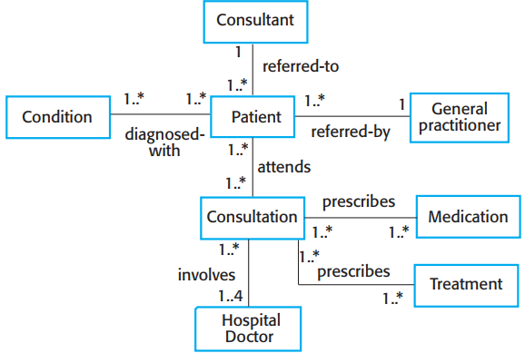

Chap. 5 System modeling
Classes and associations in the MHC-PMS
* Fig. 5.9 develops the simple class diagram in Fig. 5.8 to show that objects of class Patient are also involved in relationships with a number of other classes. You can name associations to give an indication of the type of relationship that exists.
* An exact number of objects are involved (e.g., 1..4) or, by using a *, indicate that there are an indefinite number of objects.
* When showing the associations between classes, it is best to represent the classes in the simplest possible way, without attributes or operations.
* To define objects in more detail, you add information about their attributes and operations. For example, a Patient object has the attribute Address, and you may include an operation ChangeAddress, which is called when a patient has moved.

Slide 24
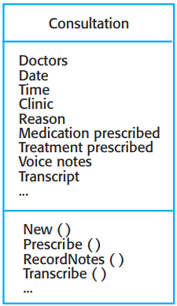
Chap. 5 System modeling
The Consultation class
* In UML, you show attributes and operations by extending the simple rectangle. Fig. 5.10 shows an object representing a consultation between doctor and patient: 还可以扩展,显示属性和操作
1. The name of the object class is in the top section.
2. The class attributes are in the middle section. This includes the attribute names and, optionally, their types.
3. The operations associated with the class are in the lower section of the rectangle.
* Here, it is assumed that doctors record voice notes that are transcribed later to record details of the consultation. To prescribe medication, the doctor involved must use the Prescribe method to generate an electronic prescription.

Slide 25
Chap. 5 System modeling
Generalization 泛化
Generalization is an everyday technique that we use to manage complexity. 泛化：管理复杂性的日常技术
Rather than learn the detailed characteristics of everything that we experience, we learn about general classes (animals, cars, houses, etc.) and learn the characteristics of these classes. 我们不是学习万物的细节特征，而是学习更泛化的类(动物、车、房子等)以及这些类的特征。
We then reuse knowledge by classifying things and focus on the differences between them and their class. For example, squirrels and rats are members of the class “rodents,” and so share the characteristics of rodents. General statements apply to all class members; for example, all rodents have teeth for gnawing. 然后，我们通过对事物分类并关注事物及其类别的区别，达到知识复用

Slide 26
Chap. 5 System modeling
Generalization practice 泛化实践
When modeling systems, it is often useful to examine the classes in a system to see if there is scope for generalization and class creation. This means that common information will be maintained in one place only. 考察系统中的类，寻找泛化和创建类的空间
This is good design practice, meaning if changes are proposed, you need not to look at all classes that may be affected by the change. You can make the changes at the most general level. 如果提出改变，无需查看受该改变影响的所有类，在更泛化的类改变即可。
In object-oriented languages, such as Java, generalization is implemented using the class inheritance mechanisms. 在Java中，泛化使用类继承机制来实现

Slide 27
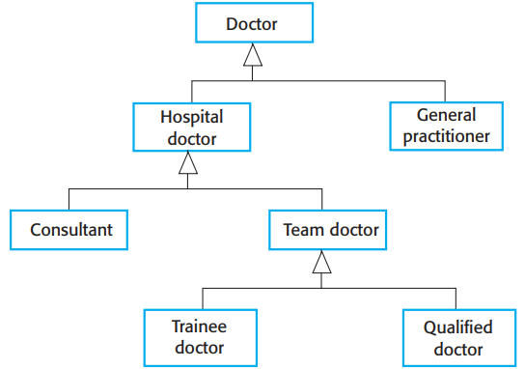

Chap. 5 System modeling
* The UML has a specific type of association to denote generalization, as illustrated in Figure 5.11.
* The generalization is shown as an arrowhead pointing up to the more general class.
* This indicates that general practitioners and hospital doctors can be generalized as doctors and that there are 3 types of Hospital Doctor: those just graduated from medical school and is supervised (Trainee Doctor); those who work unsupervised as part of a consultant’s team (Registered Doctor); and consultants, who are senior doctors.

Slide 28
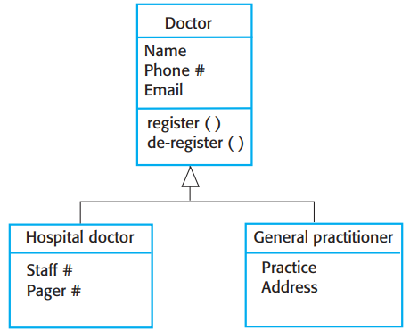

Chap. 5 System modeling
* The attributes and operations associated with higher-level classes are also associated with the lower-level classes. The lower-level classes are subclasses that inherit the attributes and operations from their superclasses. These lower-level classes then add more specific attributes and operations.
* all doctors have a name and phone number, and all hospital doctors have a staff number and carry a pager. General practitioners don’t have these attributes, as they work independently, but they have an individual practice name and address.

Slide 29
Chap. 5 System modeling
Agregation 聚集
Objects in the real world are often made up of different parts. For example, a study pack for a course may be composed of a book, PowerPoint slides, quizzes, and recommendations for further reading. 对象由不同部分组成
The UML provides a special type of association between classes called aggregation, which means that one object (the whole) is composed of other objects (the parts). To define aggregation, a diamond shape is added to the link next to the class that represents the whole. UML提供特殊类型的关联，称为聚集。含义：一个对象由其他对象组成

Slide 30

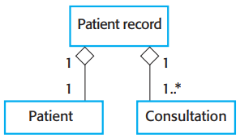
Chap. 5 System modeling
The aggregation association 聚集关联
* Figure 5.13 shows that a patient record is an aggregate of Patient and an indefinite number of Consultations.
* That is, the record maintains personal patient information as well as an individual record for each consultation with a doctor.

Slide 31
Chap. 5 System modeling
5.4 Behavioral models 行为模型
Behavioral models are models of the dynamic behavior of a system as it is executing. They show what happens or what is supposed to happen when a system responds to a stimulus from its environment. 动态行为模型：响应环境的刺激，发生事情
These stimuli may be either data or events 刺激可以是数据或事件
Data becomes available that has to be processed by the system. The availability of the data triggers the processing. 数据的可用，触发了处理过程
An event happens that triggers system processing. Events may have associated data, although this is not always the case. 事件的发生，触发了系统处理过程

Slide 32
Chap. 5 System modeling
Data-driven modeling 数据驱动建模
Data-driven models show the sequence of actions involved in processing input data and generating an associated output. 展示处理输入数据,生成相关输出的动作序列
Can be used during the analysis of requirements as they show end-to-end processing. That is, they show the entire sequence of actions that takes place from an initial input to the corresponding output, which is the system’s response. 可在分析需求时运用,因其展示了端到端的处理
Data-driven models are useful because tracking and documenting how data associated with a particular process moves through the system help analysts and designers understand the process. 有用:因为跟踪和记载与特定过程关联的数据是如何在系统中流动的，有助于分析人员和设计者理解过程。

Slide 33
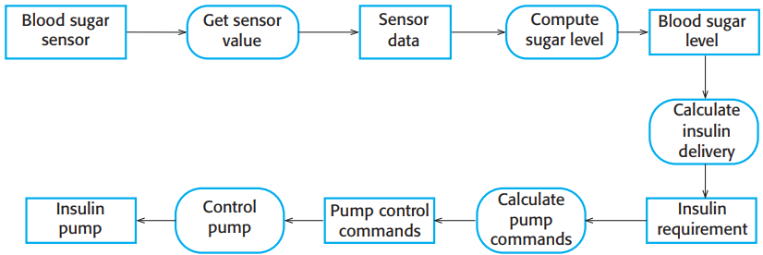
Chap. 5 System modeling
Activity model of the insulin pump’s operation
* Data-flow diagrams can be represented in the UML using the activity diagram type, described in Section 5.1.
* Figure 5.14 is a simple activity diagram that shows the chain of processing involved in the insulin pump software.
* You can see the processing steps, represented as activities (rounded rectangles), and the data flowing between these steps, represented as objects (rectangles).

Slide 34
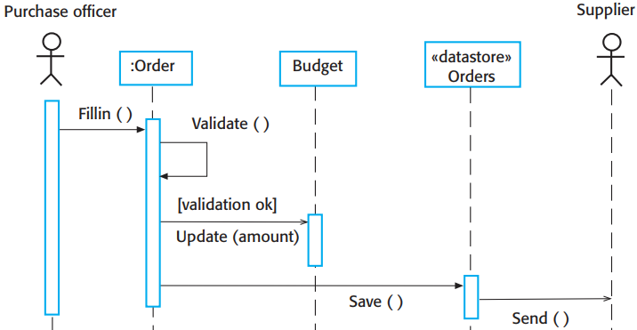
Order processing 订单处理
* An alternative way of showing the sequence of processing in a system is to use UML sequence diagrams. Fig. 5.15 uses a sequence model of processing an order and sending it to a supplier. 顺序图：处理订单，发送给提供商
* Sequence models highlight objects in a system, whereas data-flow diagrams highlight the operations or activities. In practice, nonexperts seem to find data-flow diagrams more intuitive, but engineers prefer sequence diagrams.

Slide 35
Chap. 5 System modeling
Event-driven modeling 事件驱动建模
Event-driven modeling shows how a system responds to external and internal events. It is based on the assumption that a system has a finite number of states and that events (stimuli) may cause a transition from one state to another. 展示系统如何响应外部和内部事件
Used extensively in designing and documenting real-time systems. 在实时系统设计和文档化中广泛使用
The UML supports event-based modeling using state diagrams, State diagrams show system states and events that cause transitions from one state to another. They do not show the flow of data within the system but may include additional information on the computations carried out in each state. 在UML中的支持：状态图

Slide 36
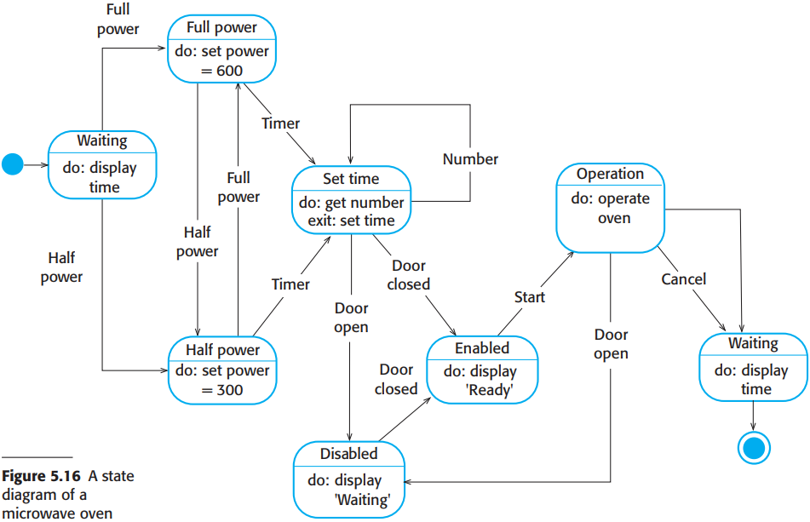
* An example of control software for a very simple microwave oven to illustrate event-driven modeling.
* The oven has a switch to select full or half power, a numeric keypad to input the cooking time, a start/stop button, and an alphanumeric display.
* The sequence of actions in using the microwave: 1. Select the power level; 2. Input the cooking time using a numeric keypad; 3. Press Start and the food is cooked for the given time.
* For safety, the oven should not operate when the door is open, and, on completion of cooking, a buzzer is sounded. The oven has a simple display to display alerts and warning messages.

Slide 37
Chap. 5 System modeling
A state diagram of a microwave oven cont’d
In UML state diagrams, rounded rectangles represent system states. They may include a brief description (following “do”) of the actions taken in that state. The labeled arrows represent stimuli that force a transition from one state to another. You can indicate start and end states using filled circles, as in activity diagrams. 符号表示
Fig. 5.16 shows: the system starts in a waiting state and responds initially to the full-power or the half-power button. Users can change their minds after selecting one and may press the other button. The time is set and, if the door is closed, the Start button is enabled. Pushing this button starts the oven operation, and cooking takes place for the specified time. This is the end of the cooking cycle, and the system returns to the waiting state. 符号示例

Slide 38

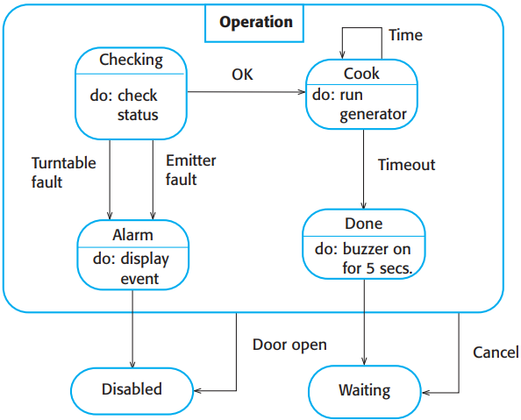
* The problem with state-based modeling is that the number of possible states increases rapidly.
* For large system models, therefore, you need to hide detail in the models.
* One way is by using the notion of a “superstate” that encapsulates a number of separate states. This superstate looks like a single state on a high-level model but is then expanded to show more detail on a separate diagram. Here the Operation state is a superstate.
* “Operation” includes a number of substates. It shows that operation starts with a status check and that if any problems are discovered an alarm is indicated and operation is disabled. Cooking involves running the microwave generator for the specified time; on completion, a buzzer is sounded. If the door is opened during operation, the system moves to the disabled state.

Slide 39
States and stimuli for the microwave oven (a)
* You normally have to extend “State models” with a more detailed description of the stimuli and the system states. You may use a table to list the states and events that stimulate state transitions along with a description of each state and event. Figure 5.18 shows a tabular description of each state and how the stimuli that force state transitions are generated.
State | Description
Waiting | The oven is waiting for input. The display shows the current time.
Half power | The oven power is set to 300 watts. The display shows ‘Half power’.
Full power | The oven power is set to 600 watts. The display shows ‘Full power’.
Set time | The cooking time is set to the user’s input value. The display shows the cooking time selected and is updated as the time is set.
Disabled | Oven operation is disabled for safety. Interior oven light is on. Display shows ‘Not ready’.
Enabled | Oven operation is enabled. Interior oven light is off. Display shows ‘Ready to cook’.
Operation | Oven in operation. Interior oven light is on. Display shows the timer countdown. On completion of cooking, the buzzer is sounded for five seconds. Oven light is on. Display shows ‘Cooking complete’ while buzzer is sounding.

Slide 40
Chap. 5 System modeling
States and stimuli for the microwave oven (b)
Stimulus | Description
Half power | The user has pressed the half-power button.
Full power | The user has pressed the full-power button.
Timer | The user has pressed one of the timer buttons.
Number | The user has pressed a numeric key.
Door open | The oven door switch is not closed.
Door closed | The oven door switch is closed.
Start | The user has pressed the Start button.
Cancel | The user has pressed the Cancel button.

Slide 41
Chap. 5 System modeling
Model-driven engineering 模型驱动的工程
Model-driven engineering (MDE) is an approach to software development whereby models rather than programs are the principal outputs of the development process. 开发过程的输出是模型而不是程序
The programs that execute on a hardware/ software platform are generated automatically from the models. 从模型自动生成程序
Proponents of MDE argue that this raises the level of abstraction in software engineering so that engineers no longer have to be concerned with programming language details or the specifics of execution platforms. 拥护者的观点：提升了抽象级别，工程师不必关心编程语言的细节或运行平台的具体情况。

Slide 42
Chap. 5 System modeling
Usage of model-driven engineering 使用情况
MDE was developed from the idea of model-driven architecture (MDA). MDE的思想来源于MDA
MDA focuses on the design and implementation stages of software development, whereas MDE is concerned with all aspects of the software engineering process. Therefore, topics such as model-based requirements engineering, software processes for model-based development, and model-based testing are part of MDE but are not considered in MDA. 两者的区别：MDA关注软件开发的设计和实现阶段；而MDE关注软件工程过程的所有方面
MDA has been adopted by a number of large companies to support their development processes. The take-up of more general MDE has been slow. MDA被一些大公司采用，但MDE接受度低

Slide 43
Chap. 5 System modeling
5.5 Model-driven architecture 模型驱动的体系结构
MDA is a model-focused approach to software design and implementation that uses a subset of UML models to describe a system. 含义: 关注模型的设计和实现方法，用UML模型描述系统
Models at different levels of abstraction are created. 创建不同级别的抽象模型
From a high-level, platform independent model, it is possible, in principle, to generate a working program without manual intervention. 从高层、平台无关模型，能生成可运行程序，无需人工干预

Slide 44
Chap. 5 System modeling
Types of model - 3 types 模型的种类
A computation independent model (CIM): CIMs model the important domain abstractions used in a system and so are sometimes called domain models. You may develop several different CIMs, reflecting different views of the system. 计算无关模型
A platform-independent model (PIM): PIMs model the operation of the system without reference to its implementation. A PIM is usually described using UML models that show the static system structure and how it responds to external and internal events. 平台无关模型
Platform-specific models (PSM): Are transformations of the PIM with a separate PSM for each application platform. In principle, there may be layers of PSM, with each layer adding some platform-specific detail. 平台相关模型

Slide 45
Chap. 5 System modeling
MDA transformations MDA转换
Model-based engineering allows engineers to think about systems at a high level of abstraction, without concern for the details of their implementation. This reduces the likelihood of errors, speeds up the design and implementation process, and allows for the creation of reusable, platform-independent application models. 在高抽象层次看待系统，无需关心实现的细节
By using powerful tools, system implementations can be generated for different platforms from the same model. Therefore, to adapt the system to some new platform, you write a model translator for that platform. When this is available, all platform-independent models can then be rapidly re-hosted on the new platform. 使用强大的工具,可从同一个模型,针对不同平台,生成系统实现

Slide 46
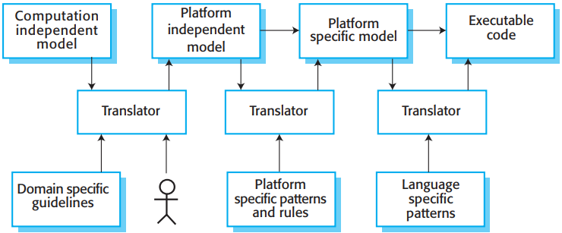

CIM
PIM
PSM
* Fundamental to MDA is the notion that transformations between models can be defined and applied automatically by software tools, as illustrated in Figure 5.19.
* This diagram also shows a final level of automatic transformation where a transformation is applied to the PSM to generate the executable code that will run on the designated software platform. Therefore, in principle at least, executable software can be generated from a high-level system model.
* In practice, completely automated translation of models to code is rarely possible. The translation of high-level CIM to PIM models remains a research problem, and for production systems, human intervention, illustrated using a stick figure in Figure 5.19, is normally required.

Slide 47
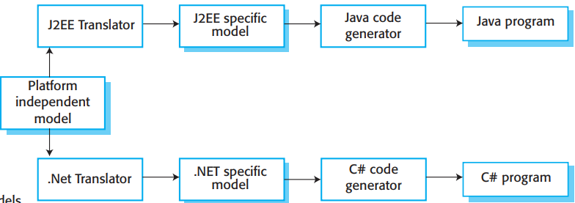

PIM
* The translation of PIM to PSM is a simpler technical problem. Commercial tools and open-source tools are available that provide translators from PIMs to common platforms such as Java and J2EE. These use an extensive library of platform-specific rules and patterns to convert a PIM to a PSM. There may be several PSMs for each PIM in the system. If a software system is intended to run on different platforms (e.g., J2EE and .NET), then, in principle, you only have to maintain a single PIM. The PSMs for each platform are automatically generated (Figure 5.20).
* Although MDA support tools include platform-specific translators, these sometimes only offer partial support for translating PIMs to PSMs. The execution environment for a system is more than the standard execution platform, such as J2EE or Java. It also includes other application systems, specific application libraries that may be created for a company, external services, and user interface libraries.

Slide 48
Chap. 5 System modeling
Adoption of MDA MDA的采用
When MDA is introduced into an organization, special-purpose translators may have to be created to make use of the facilities available in the local environment. This is one reason why many companies have been reluctant to take on model-driven approaches to development. 当引入MDA时，必须创建专用的转换器，以利用局部环境可获得的设施。因此，很多公司不愿意使用....
They do not want to develop or maintain their own tools or to rely on small software companies, who may go out of business, for tool development. Without these specialist tools, model-based development requires additional manual coding which reduces the cost-effectiveness of this approach. 原因：它们不想维护自己的工具或依靠小公司的工具。因而,需要额外手工编码,降低了MDA方法的成本效益

Slide 49
Chap. 5 System modeling
Adoption of MDA, cont’d
Several other reasons why MDA has not become a mainstream approach：MDA没成为主流的其他原因
1. Models are a good way of facilitating discussions about a software design. However, it does not always follow that the abstractions that are useful for discussions are the right abstractions for implementation. You may decide to use a completely different implementation approach that is based on the reuse of off-the-shelf application systems. 抽象对讨论有用,对实现未必对。可能使用完全不同的实现方法--复用成品系统
2. For most complex systems, implementation is not the major problem—requirements engineering, security and dependability, integration with legacy systems and testing are more significant. Consequently, the gains from the use of MDA are limited. 对于多数复杂系统，使用MDA的收益是有限的

Slide 50
Chap. 5 System modeling
Adoption of MDA, cont’d
Several other reasons why MDA has not become a mainstream approach: MDA没成为主流的其他原因（续）
3. The arguments for platform independence are only valid for large, long-lifetime systems, where the platforms become obsolete during a system’s lifetime. For systems that are developed for standard platforms, such as Windows and Linux, the savings from the use of MDA are likely to be outweighed by the costs of its introduction and tooling. 平台无关性只对大、长生命期系统有效；对于针对标准平台开发的系统，引入MDA的成本可能会超出使用MDA的收益
4. The widespread adoption of agile methods over the same period that MDA was evolving has diverted attention away from model-driven approaches. 同时期敏捷方法的广泛采用，将注意力从模型驱动方法转移走了

Slide 51
Chap. 5 System modeling
MDA practice MDA实践
The success stories for MDA have mostly come from companies that are developing systems products, which include both hardware and software. The software in these products has a long lifetime and may have to be modified to reflect changing hardware technologies. The domain of application (automotive, air traffic control) is often well understood and can be formalized in a CIM. 成功故事多来自于系统产品(包括硬件和软件)开发公司
There is an uneasy relationship between agile methods and MDA. The notion of extensive up-front modeling contradicts the fundamental ideas in the agile manifesto and few agile developers feel comfortable with model-driven engineering. 敏捷方法与MDA关系不和谐

Slide 52
Chap. 5 System modeling
Key points
A model is an abstract view of a system that ignores system details. Complementary system models can be developed to show the system’s context, interactions, structure and behavior.
Context models show how a system that is being modeled is positioned in an environment with other systems and processes.
Use case diagrams and sequence diagrams are used to describe the interactions between users and systems in the system being designed. Use cases describe interactions between a system and external actors; sequence diagrams add more information to these by showing interactions between system objects.
Structural models show the organization and architecture of a system. Class diagrams are used to define the static structure of classes in a system and their associations.

Slide 53
Chap. 5 System modeling
Key points
Behavioral models are used to describe the dynamic behavior of an executing system. This behavior can be modeled from the perspective of the data processed by the system, or by the events that stimulate responses from a system.
Activity diagrams may be used to model the processing of data, where each activity represents one process step.
State diagrams are used to model a system’s behavior in response to internal or external events.
Model-driven engineering is an approach to software development in which a system is represented as a set of models that can be automatically transformed to executable code.

